Slide 1














Disney+HotStar Data Analysis
Presented by Ajay Kumar.G
Batch code : MBT12

Slide 2
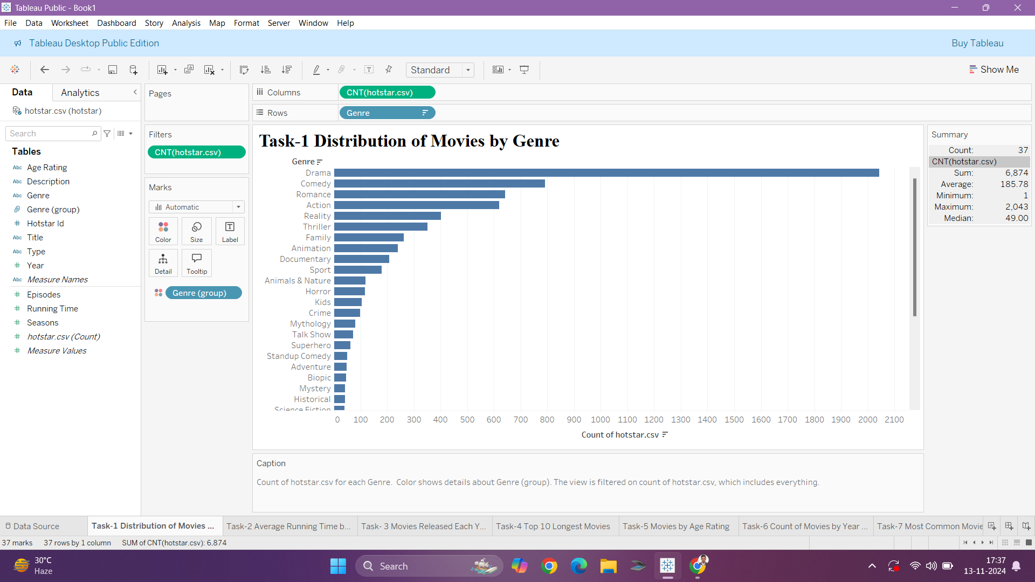
Conclusion:
The distribution of movies by genre on Hotstar shows a strong focus on popular genres like Drama, Comedy, Romance, and Action, with fewer offerings in niche genres such as Adventure, Biopic, and Science Fiction.

Slide 3
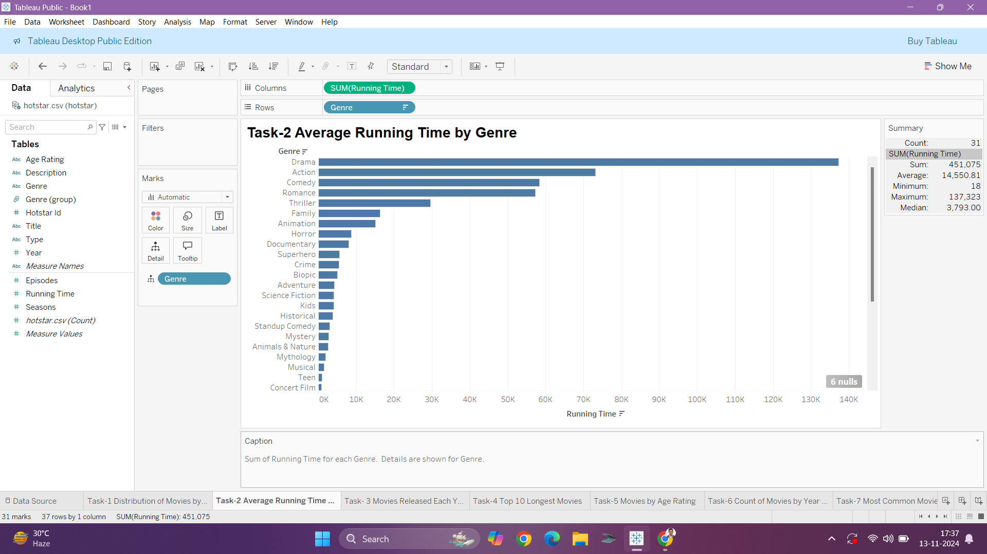
Conclusion:
The visualization reveals that the Drama genre has the highest average running time among the genres in the dataset.

Slide 4
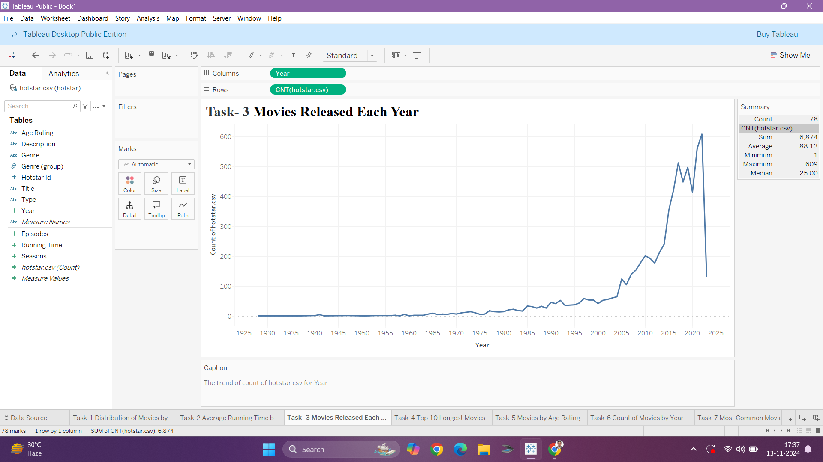
Conclusion:
The line chart illustrates the upward trend in the number of movies released each year, with a significant increase in the later years of the dataset.

Slide 5
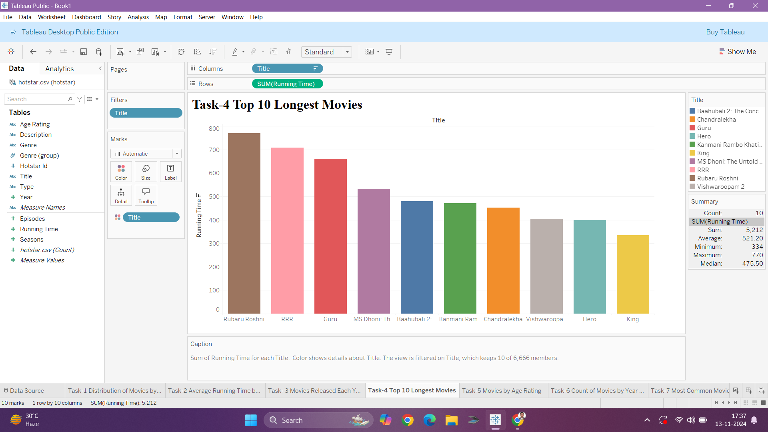
Conclusion:
The bar chart highlights the top 10 longest movies in the list 1st Rubaru Roshni 2nd RRR and 3rd Guru. These are the longest movies.

Slide 6
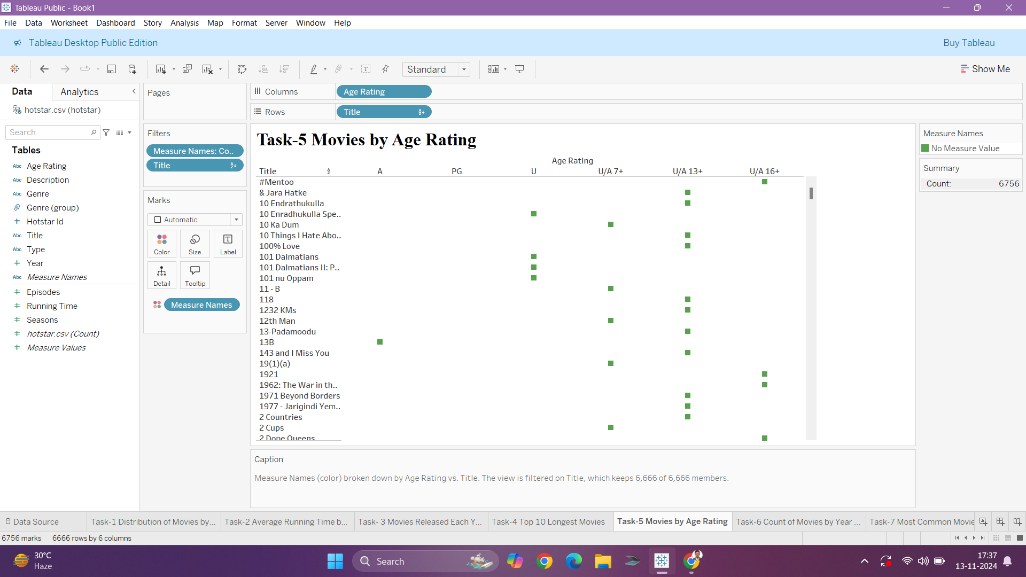
Conclusion:
The scatter plot illustrates the distribution of movies across different age ratings, with the majority falling under the U/A category.

Slide 7
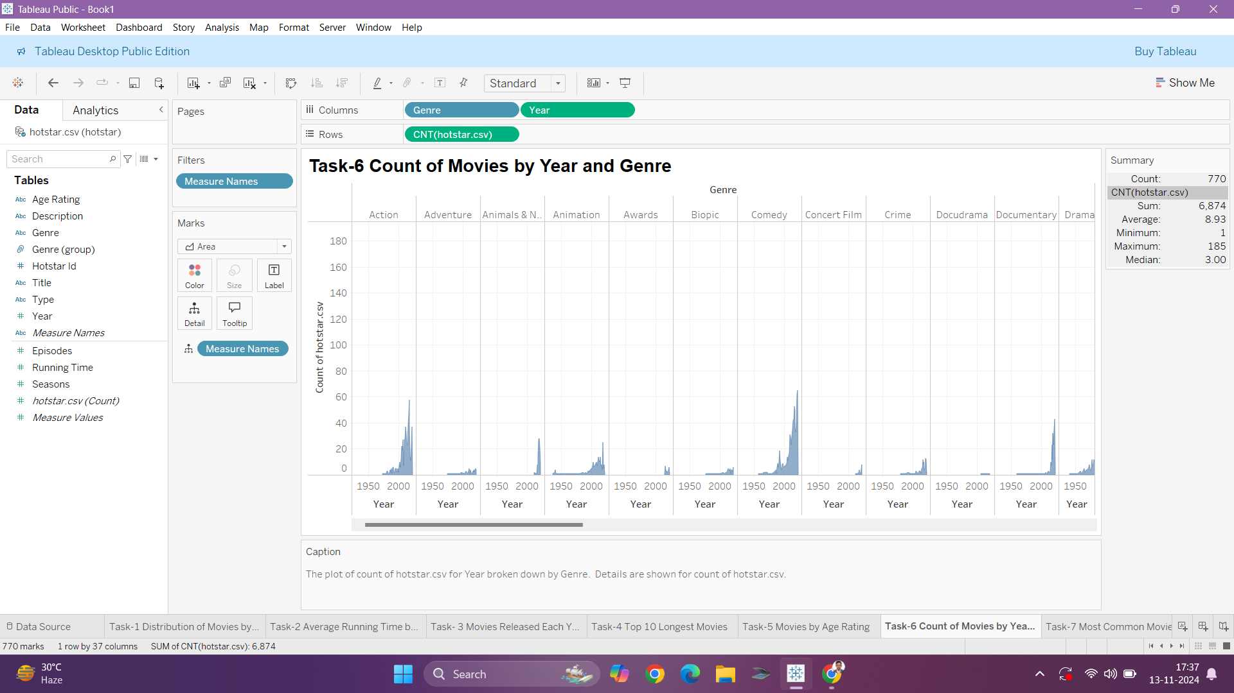
Conclusion:
The plot visualizes the count of movies released each year, broken down by genre, revealing a steady increase in the number of movies across most genres over time.

Slide 8
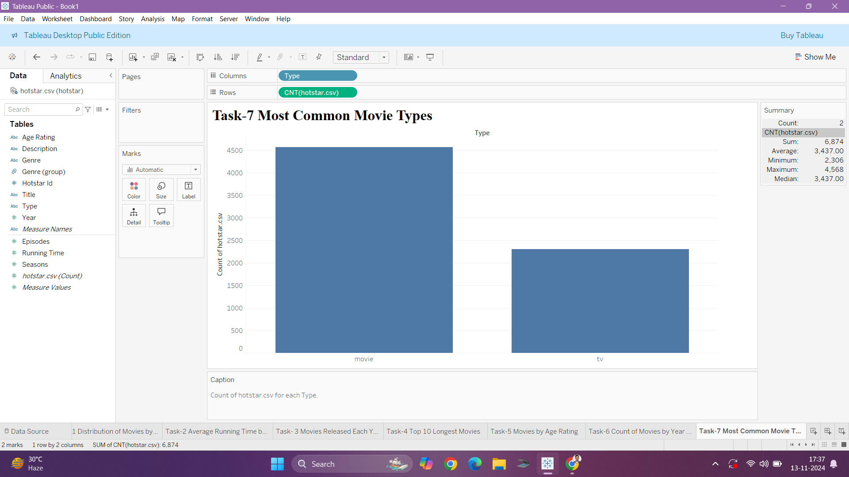
Conclusion:
The bar chart shows that movies are the most common type of content in the dataset, followed by TV shows.

Slide 9
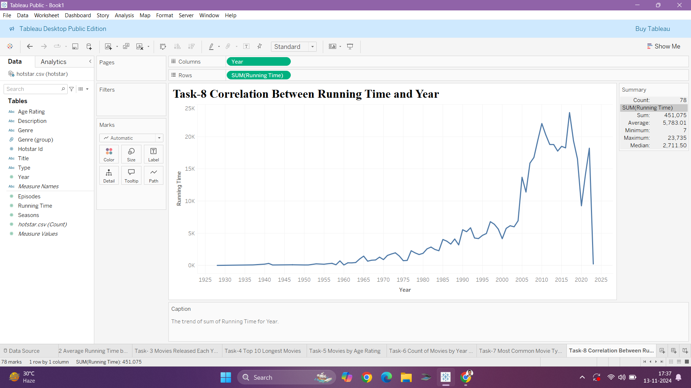
Conclusion:
The line chart shows the trend of the sum of running time for each year, revealing fluctuations over time.

Slide 10
Observations from the Chart:
General Trend: There’s an upward trend in the running time over the years, especially noticeable post-1970, with significant fluctuations after 2000.
Visual Implications: A general positive correlation is evident; as years progress, the total running time tends to increase.
Recent Decline: The sharp drop around 2020 could indicate data limitations or unusual circumstances (e.g., fewer movies due to the COVID-19 pandemic).

Slide 11
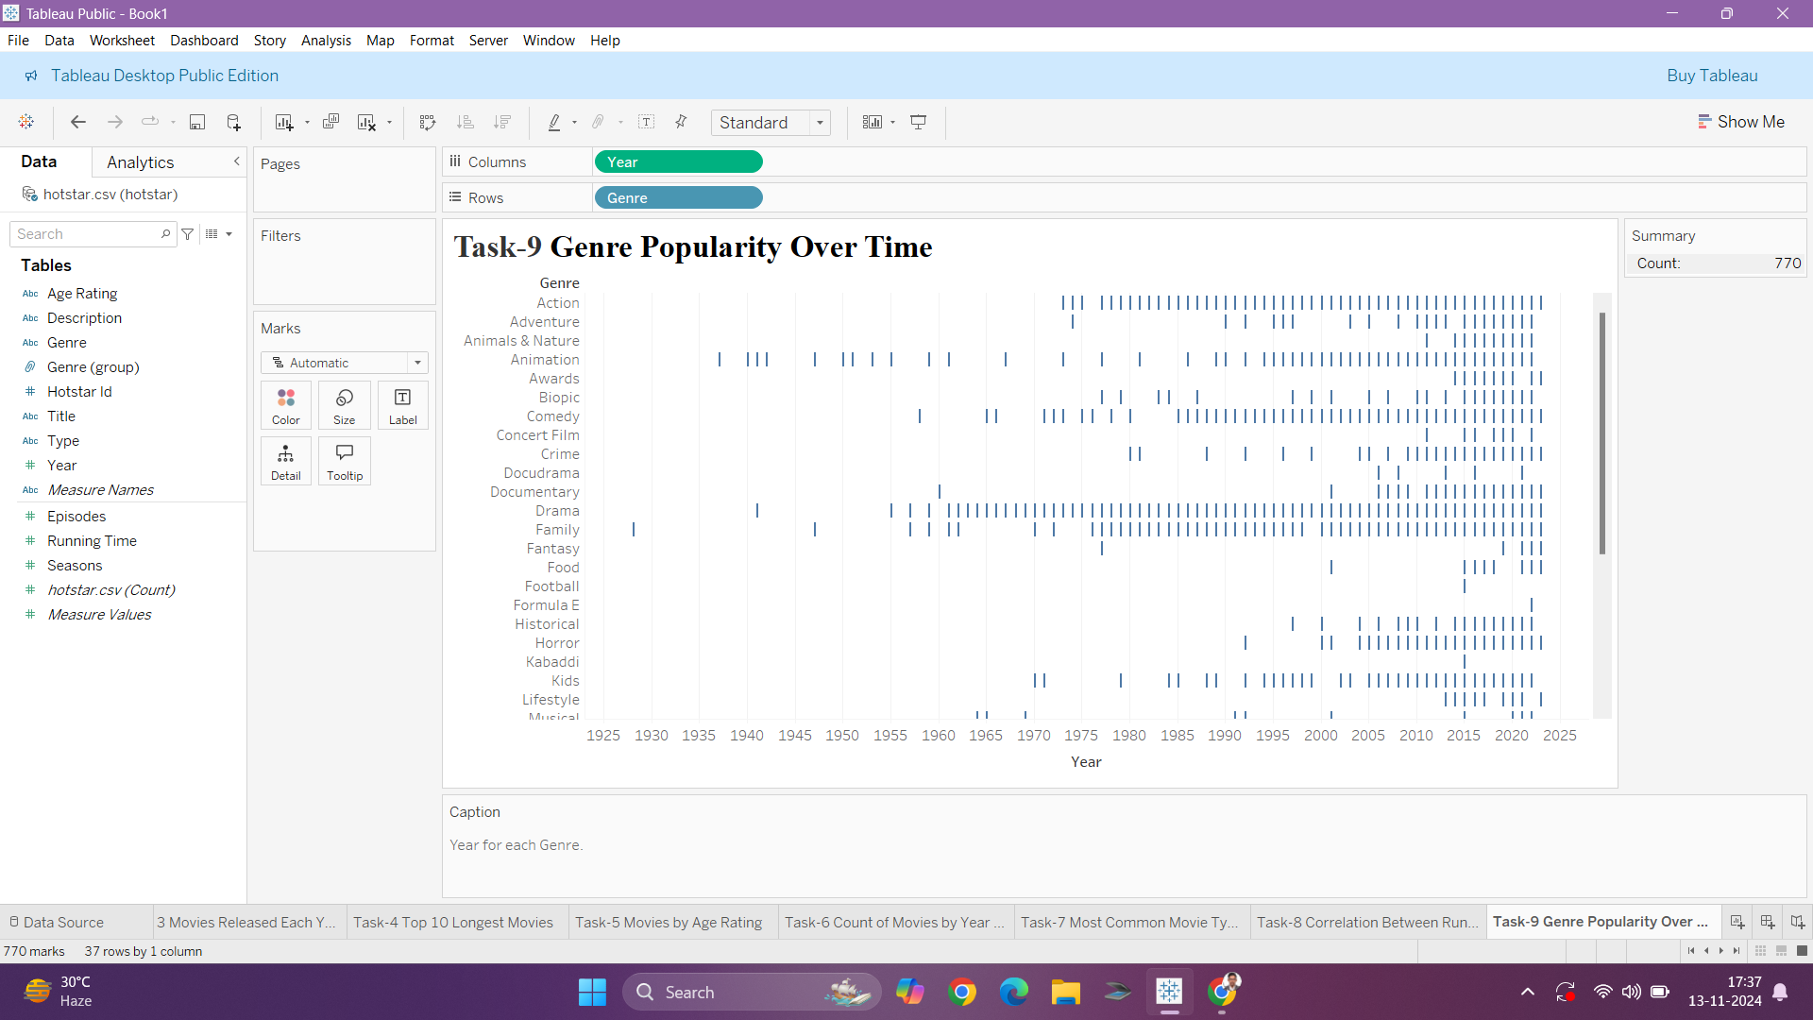
Conclusion:
The plot visualizes the popularity of each genre over time, showing the distribution of movies for each genre across different years.

Slide 12
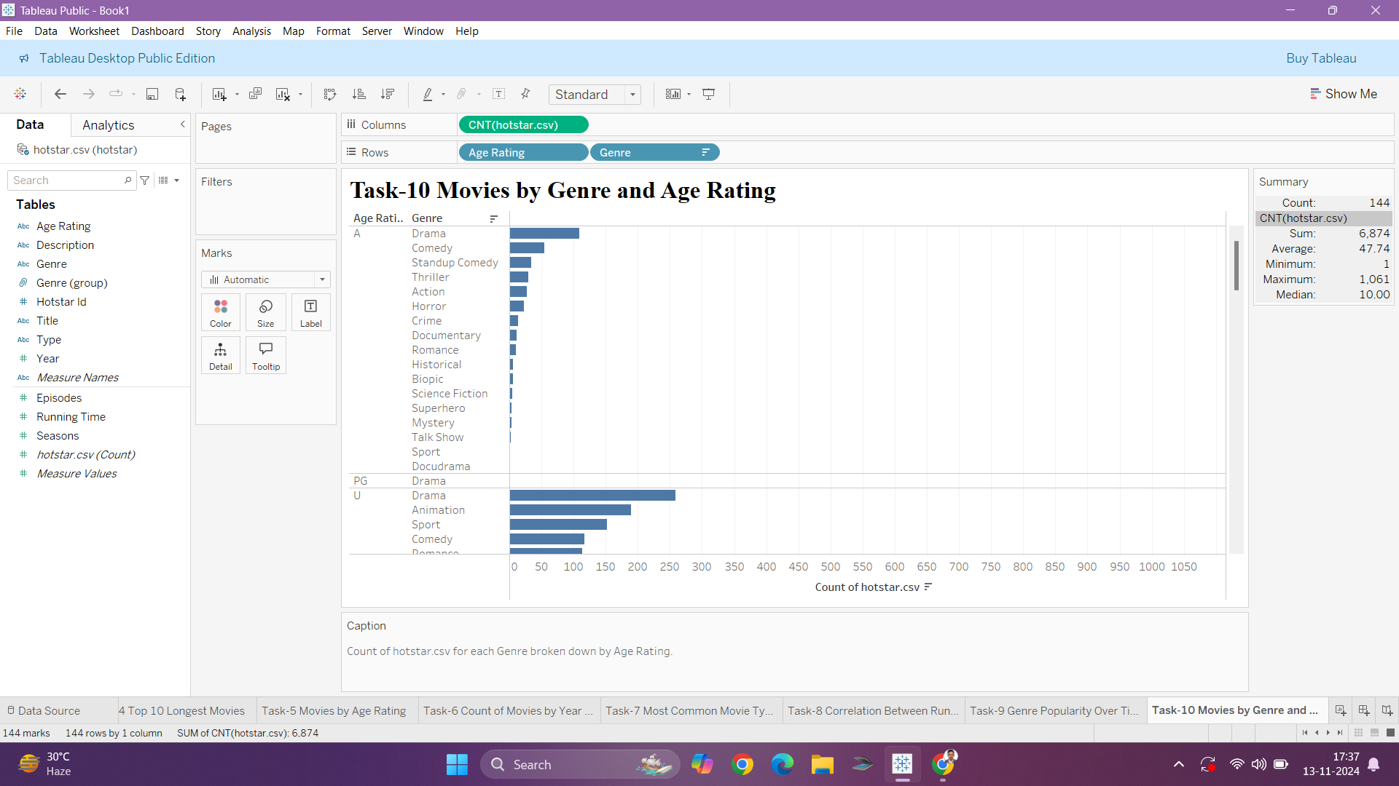
Conclusion:
The bar chart shows the top 10 genres by the count of movies, with Drama being the most prevalent genre in the dataset.

Slide 13
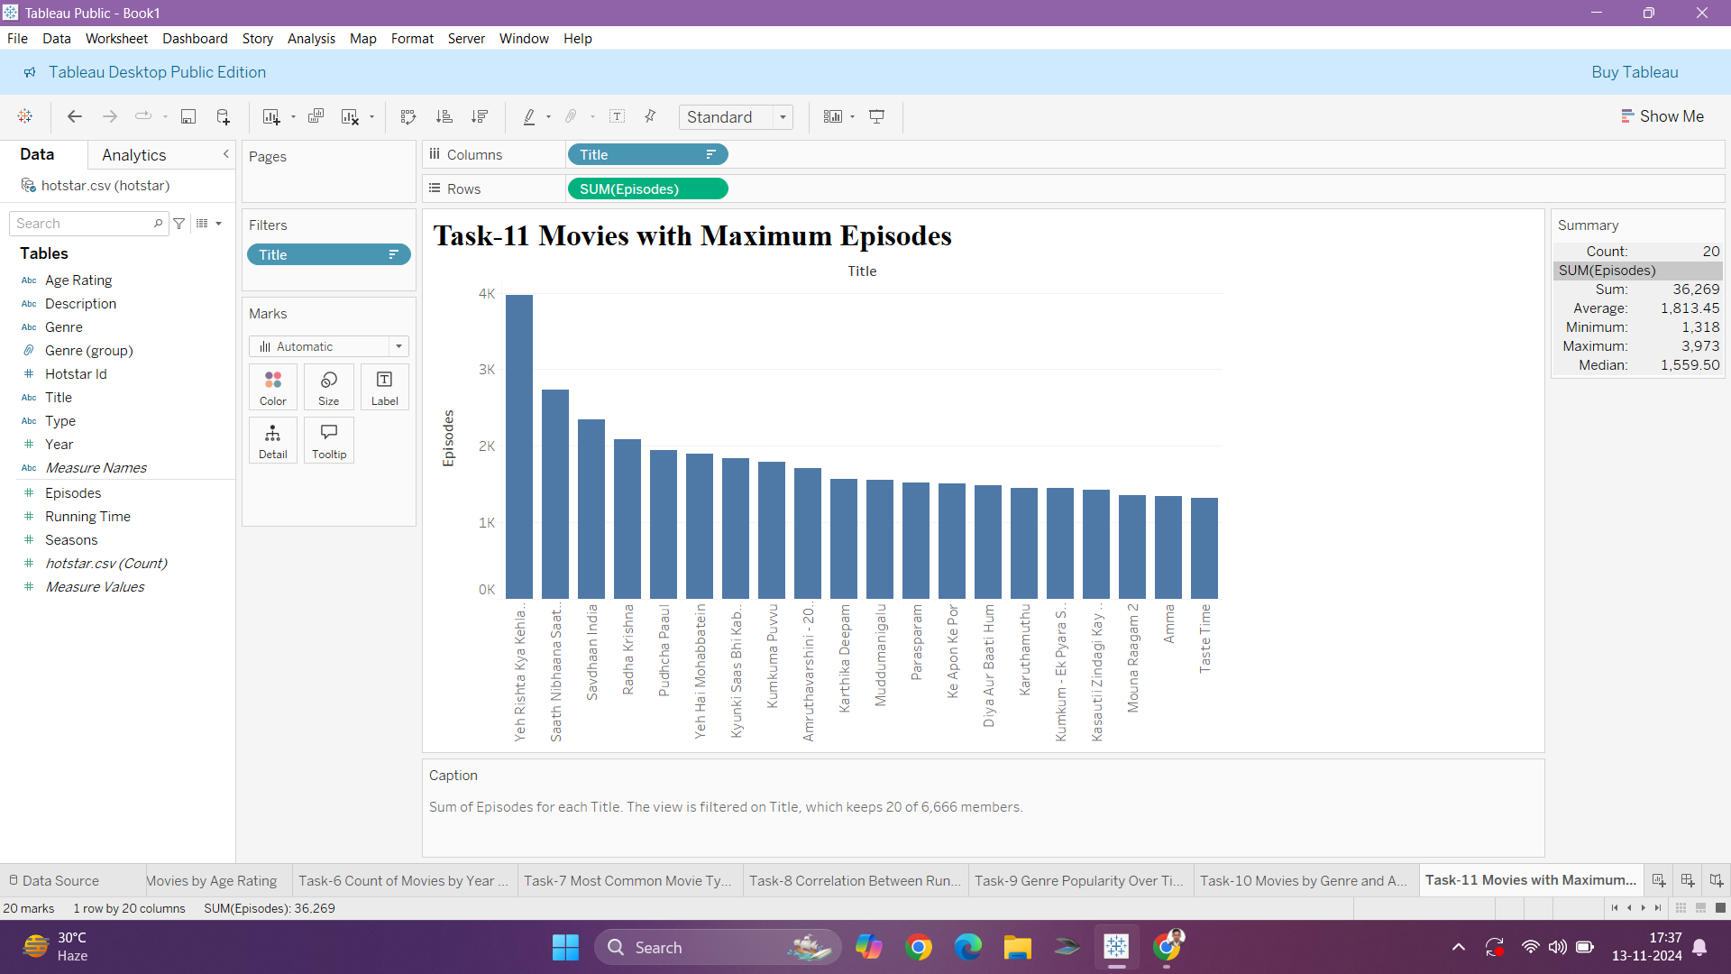
Conclusion:
The bar chart shows the top 20 movies with the maximum number of episodes, with "Yeh Rishta Kya Kehlata Hai" having the most episodes.

Slide 14
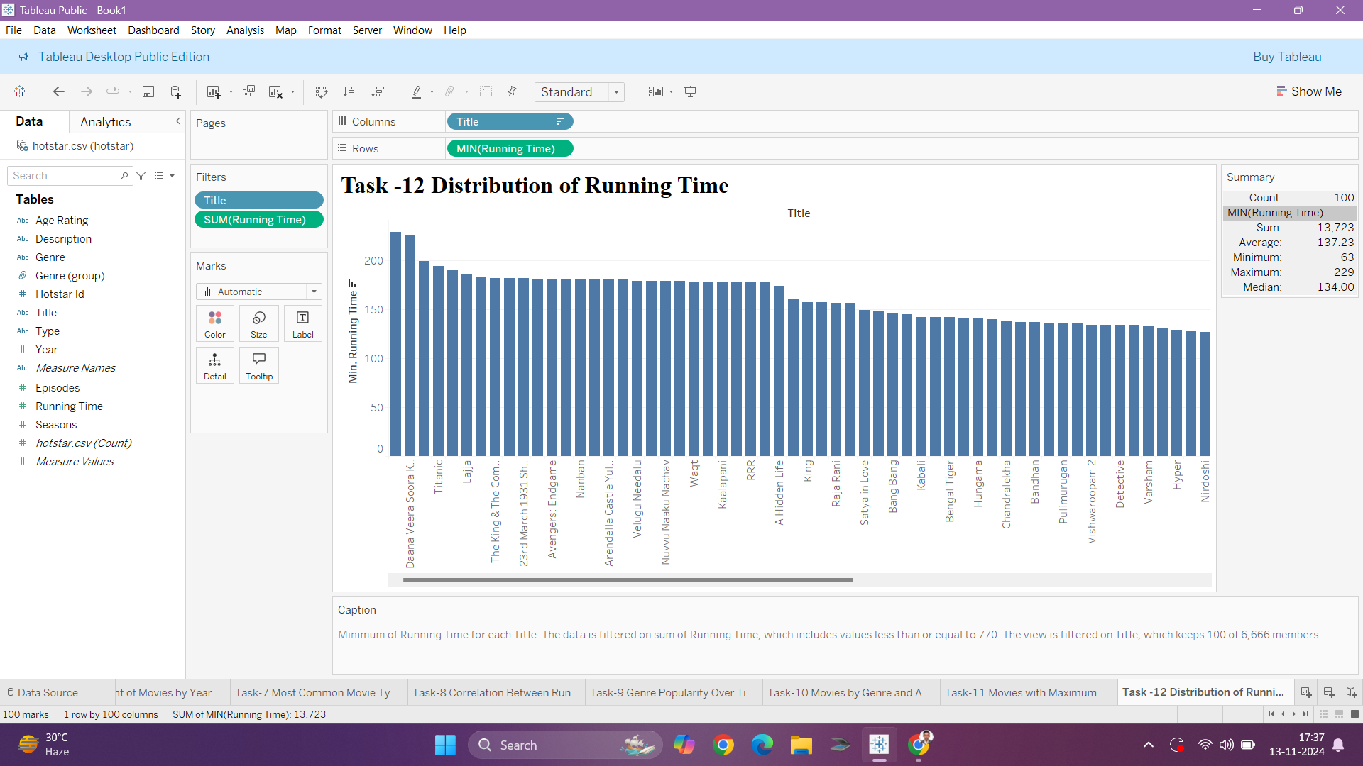
Conclusion:
The bar chart shows the distribution of movies by their running time, with the movies having the highest running time on the left.

Slide 15
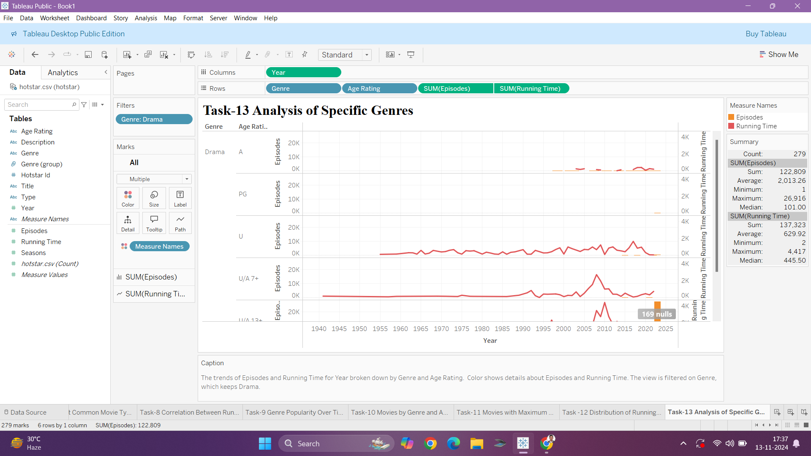
Conclusion:
The plot visualizes the trend of episodes and running time for each year, broken down by genre and age rating, with a focus on the Drama genre.

Slide 16
BUSINESS RECOMMENDATIONS
Expand Niche Genres: The current focus is on popular genres like Drama, Comedy, Romance, and Action, with fewer offerings in genres such as Adventure, Biopic, and Science Fiction. Adding more niche genres could attract diverse viewers and satisfy untapped market segments​.
Optimize Content by Age Rating: Most content falls under the U/A category. Disney+ Hotstar could create more content for specific age ratings, such as family-friendly content or mature-themed shows, to cater to a broader audience spectrum​.
Increase High-Running-Time Content: The longest movies, like Rubaru Roshni and RRR, tend to attract viewers who prefer long-form content. Developing and promoting similar high-running-time content could retain users on the platform longer and enhance engagement metrics.
Leverage Trending Genres: The upward trend in Drama content and its high average running time suggests a strong viewer base. Leveraging this trend by producing high-quality drama content and exploring subgenres within Drama could solidify Hotstar's position in this popular genre.
Develop Series with High Episode Counts: Shows like Yeh Rishta Kya Kehlata Hai, with a high number of episodes, indicate strong user loyalty. Creating or acquiring similar long-running shows could increase user retention.

Slide 17
Thank you very much!

